Slide 1
Diffie–Hellman key exchange
The Diffie-Hellman key exchange was the first widely used method of safely developing and exchanging keys over an insecure channel.
The Diffie–Hellman key exchange method allows two parties that have no prior knowledge of each other to jointly establish a shared secret key over an insecure channel
This key can then be used to encrypt subsequent communications using a symmetric key cipher

Slide 2
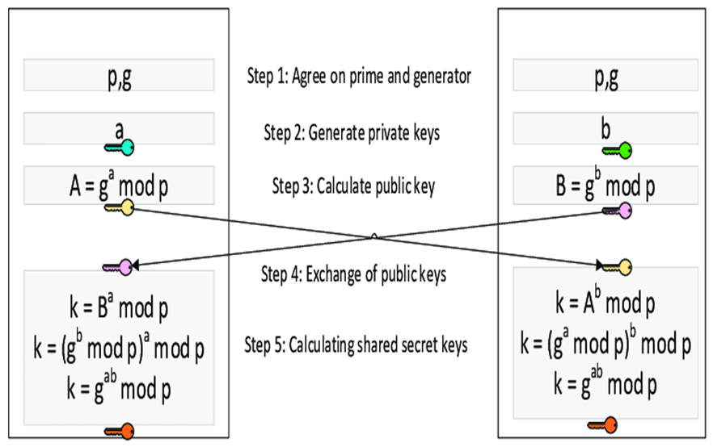
Diffie Hellman Key Exchange Algorithm
SENDER
RECEIVER
0<=a,b<=p-1

Slide 3
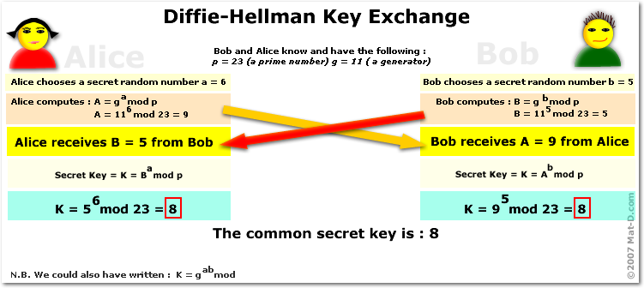

Slide 4
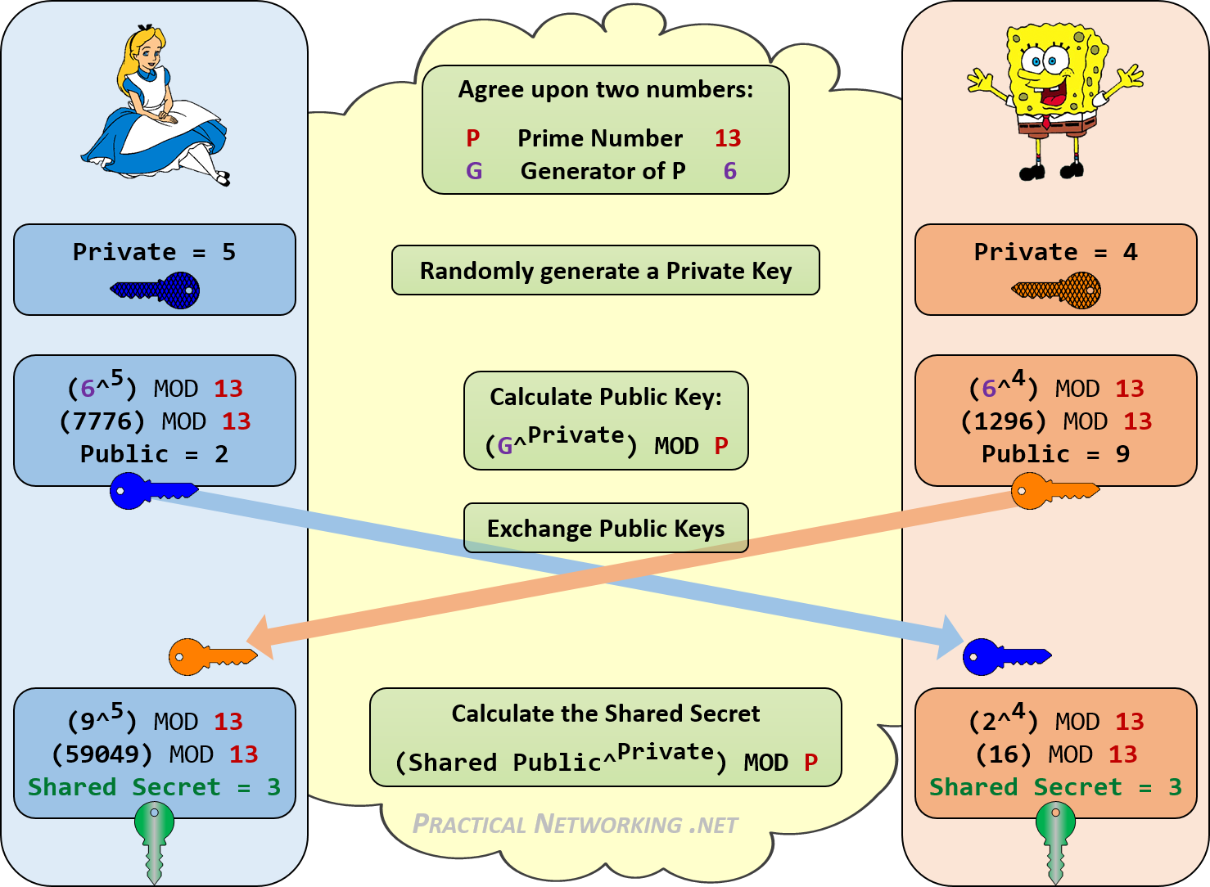

Slide 5
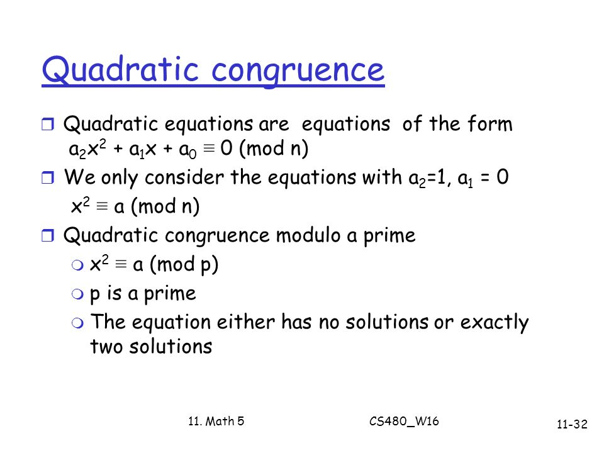

Slide 6

Quadratic Residues & Nonresidue
In the equation x² a (mod p)
a is called a quadratic residue (QR) if the equation has two solutions
a is called quadratic nonresidue (QNR) if the equation has no solution

Slide 7
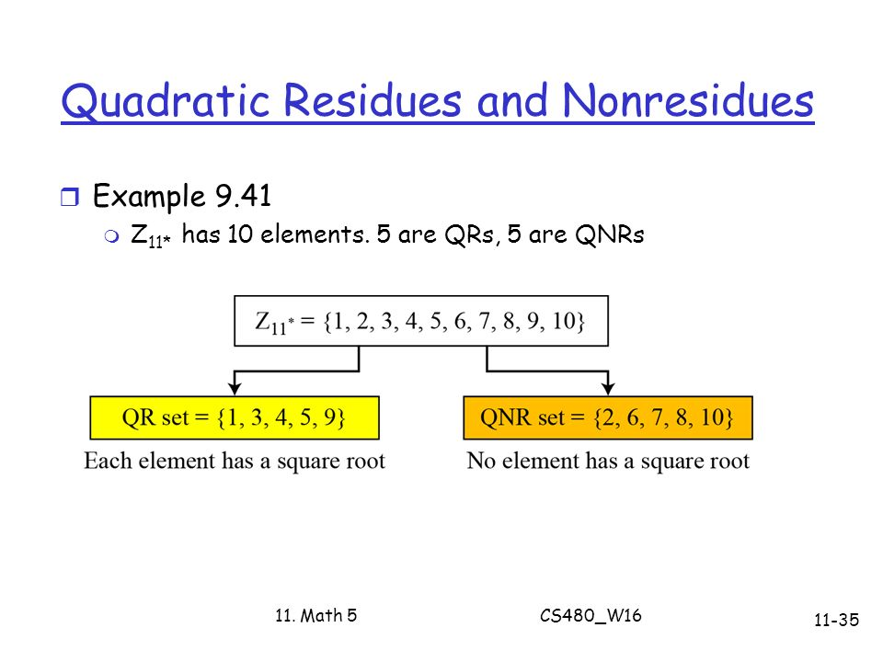

Slide 8
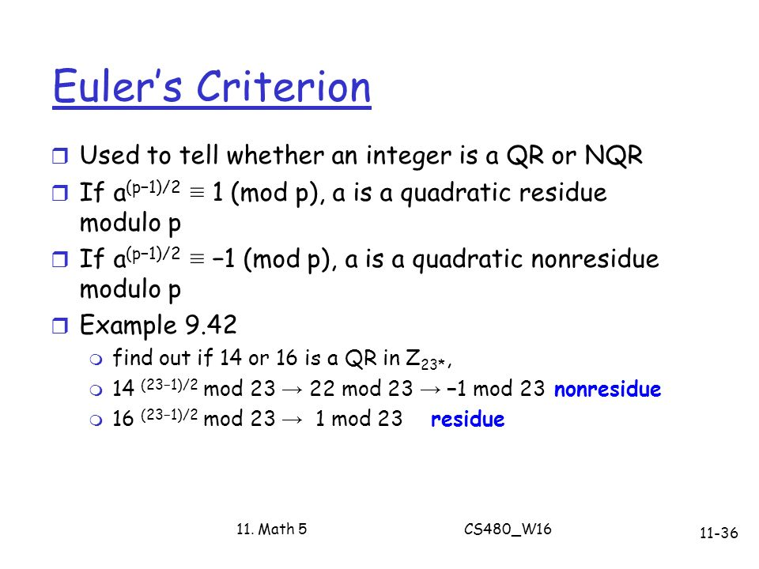

Slide 9
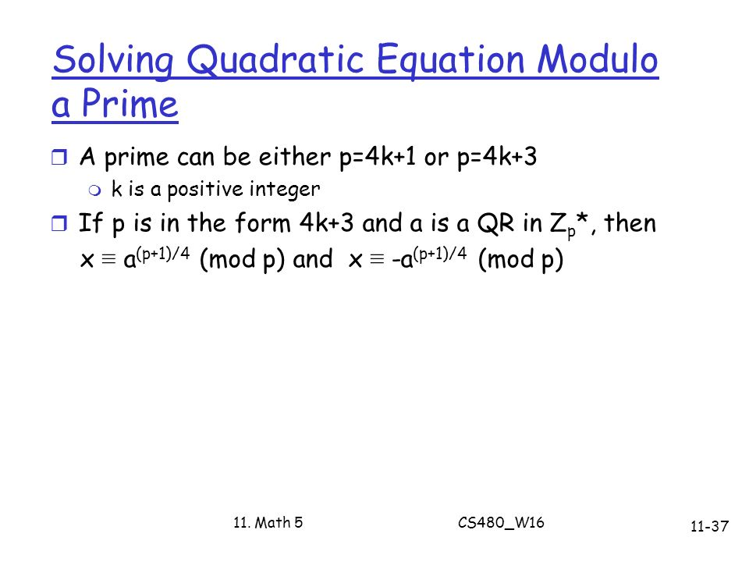

Slide 10
